Slide 1
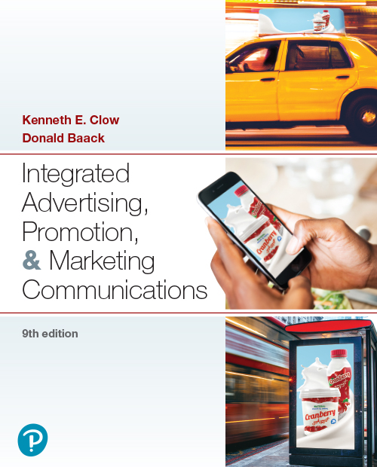

Integrated Advertising, Promotion, and Marketing Communications
Ninth Edition
Chapter 5
Advertising Campaign Management
Copyright © 2022, 2018, 2016 Pearson Education, Inc. All Rights Reserved
Notes:
If this PowerPoint presentation contains mathematical equations, you may need to check that your computer has the following installed:
1) MathType Plugin
2) Math Player (free versions available)
3) NVDA Reader (free versions available)

Slide 2
Chapter Objectives (1 of 2)
5.1 How do advertising theories guide the advertising management process?
5.2 What is the relationship of advertising expenditures to advertising effectiveness?
5.3 When should a company employ an external advertising agency rather than completing the work in-house?
5.4 How do companies choose advertising agencies?
Notes:
These are the objectives for Chapter 5.

Slide 3
Chapter Objectives (2 of 2)
5.5 What job functions take place within an advertising agency?
5.6 What advertising campaign parameters do marketing professionals consider?
5.7 How does a creative brief facilitate effective advertising?
5.8 What are the implications of advertising management in the global arena?
Notes:
These are additional objectives for Chapter 5.

Slide 4
Chapter Overview
Advertising management
Advertising theory
Relationship of advertising expenditures to success
Choosing an advertising agency
Advertising parameters
The creative brief
Notes:
This chapter presents an overview of managing the advertising function. Advertising theory lays the groundwork as does an understanding of the relationship between advertising expenditures and success. The chapter then provides information on how to select an advertising agency. Advertising parameters are discussed, as well as the components of a creative brief.

Slide 5

Zehnder Communications
Full-service agency
Challenges traditional thinking
Innovation
Campaign integration
Named a “best place to work” 12 years in a row
Notes:
Zehnder Communications is a full-service agency that offers strategic planning as well as advertising services. The agency serves a number of clients whose ads appear in this textbook. The goal is to remain at the forefront of innovation to develop new ways to reach consumers. The agency believes in campaign integration as a way to connect with a client’s audience. In addition to its advertising expertise, Zhender has been recognized as a “best place to work.”

Slide 6
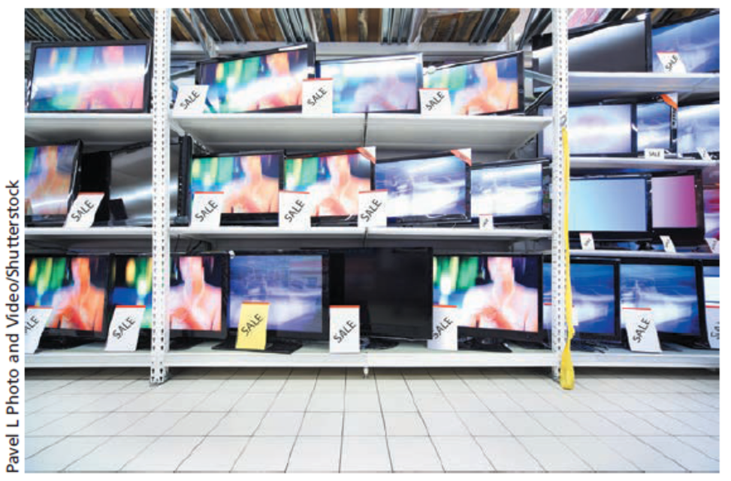
Hierarchy of Effects Model (1 of 2)
Awareness
Knowledge
Liking
Preference
Conviction
Purchase
Notes:
The hierarchy of effects model consists of these six steps. When making a high-involvement purchase, such as for the big-screen television shown here, the consumers will typically go through all six hierarchy of effects steps.

Slide 7
Hierarchy of Effects Model (2 of 2)
Steps are sequential
Some experts question if sequential
Consumers spend time at each step
Brand loyalty involves all six steps
Similar to attitude formation
Cognitive → affective → conative
Cognitive – awareness, knowledge
Affective – liking, preference, conviction
Conative – actual purchase
Notes:
The six steps are sequential, although some experts question if they are really sequential. But, the basic model says they are sequential and that consumers spend some time at each step. For instance, before a consumer can like a brand, they first must be aware of it and develop some knowledge of it. To develop brand loyalty, consumers must go through all six steps. It is similar to attitude formation and the cognitive-affective-conative sequence. Awareness and knowledge are the cognitive component of attitude. Liking, preference, and conviction are the affective component. The conative component of attitude is the purchase.

Slide 8
Figure 5.1: Personal Values
Comfortable life
Equality
Excitement
Freedom
Fun, exciting life
Happiness
Inner peace
Mature love
Personal accomplishment
Pleasure
Salvation
Security
Self-fulfilment
Self-respect
Sense of belonging
Social acceptance
Wisdom
Notes:
In designing ads, it is important to remember people have different values, and much of their consumption behavior is motivated by a desire to fulfill these values in their lives.

Slide 9
Means-End Theory
Means-end chain
Message (means) leads to end state (personal values)
Means-End Conceptualization of Components of Advertising Strategy (M E C C A S)
Product attributes → benefits → personal values
Notes:
The second theory that is important to consider is the means-end theory. The basic concept is that a means, the message, leads to an end state, or personal value. The actual name of the theory is “Means-End Conceptualization of Components of Advertising Strategy,” or MECCAS. The model suggests that product attributes lead to consumer benefits, which in turn connect to personal values.

Slide 10
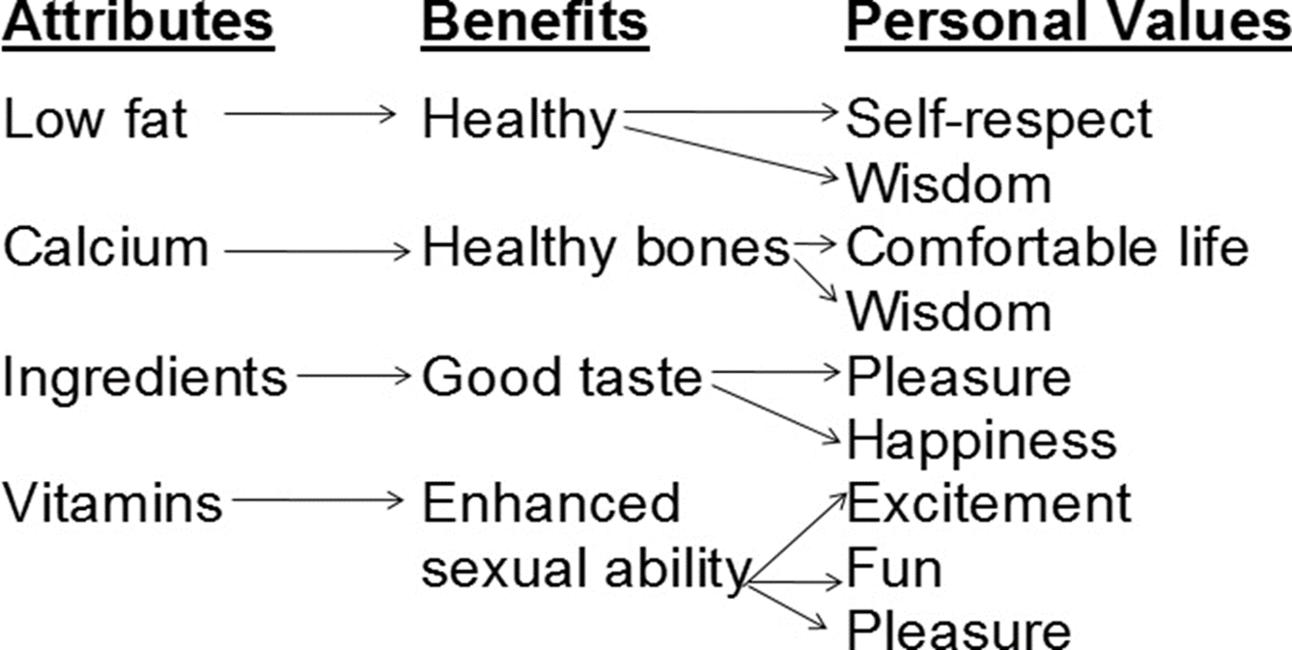
Figure 5.2: Means-End Chain for Milk (1 of 2)
Notes:
This figure illustrates a means-end chain for milk. An attribute of milk, being low fat, provides the benefit of health. The personal values consumers receive from good health are self-respect and wisdom. Another attribute, calcium, provides the benefit of healthy bones, which in turn leads to a comfortable life and shows wisdom on the part of the consumer. The key to a means-end chain is looking at the benefits each attribute generates, then connecting those benefits to various personal values.
The diagram has concepts listed from top to bottom, which flow into other concepts from left to right structured as follows.
Low fat
Healthy
Self respect
Wisdom
Calcium
Healthy bones
Comfortable life
Wisdom
Ingredients
Good taste
Pleasure
Happiness
Vitamins
Enhanced sexual ability
Excitement
Fun
Pleasure

Slide 11

Figure 5.2: Means-End Chain for Milk (2 of 2)
Illustration of the Means-End Chain
Notes:
This advertisement for milk illustrates the last means-end chain. The specific message is that milk has calcium, which is important in bone development for both the mother and her baby.

Slide 12
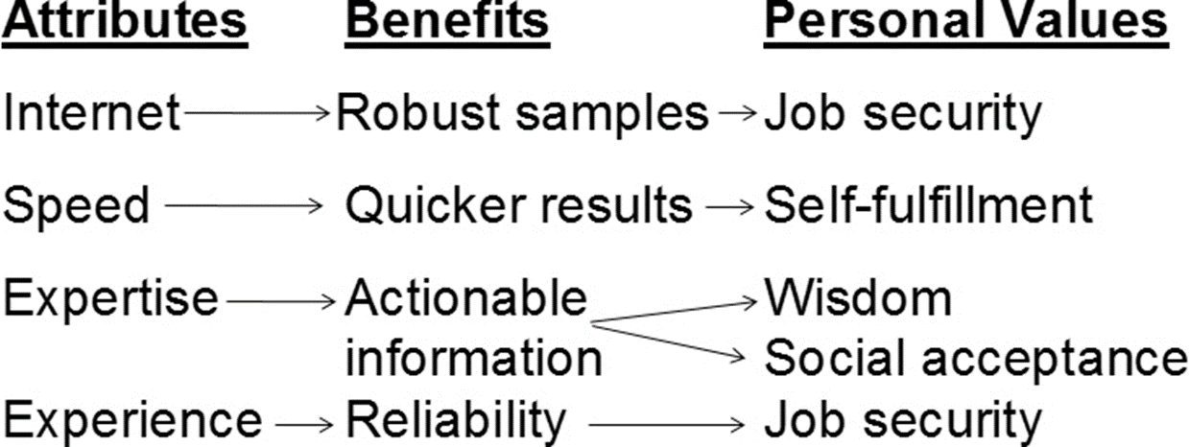
Figure 5.3: B-to-B Means-End Chain for Marketing Research Services (1 of 2)
Notes:
This is a means-end chain for a marketing research firm, such as ReRez. The company is promoting marketing research. The first attribute is that ReRez does marketing research using the internet which provides the benefit of robust samples. For a marketing person in a company, using robust samples can provide job security. Another aspect of the service, speed, leads to quicker results. This can provide the benefit of self-fulfillment since the information needed is provided quickly. Other personal values that are tapped through the benefits suggested include social acceptance and wisdom.
The diagram has concepts listed from top to bottom, which flow into other concepts from left to right structured as follows.
Internet
Robust samples
Job security
Speed
Quicker results
Self fulfillment
Expertise
Actionable information
Wisdom
Social acceptance
Experience
Reliability
Job security

Slide 13

Figure 5.3: B-to-B Means-End Chain for Marketing Research Services (2 of 2)
Illustration of the Means-End Chain
Notes:
This ad for ReRez is based on the means-end chain shown here.
The title reads, Re Rez takes responsibility for making sure the project gets done, what a great idea. The ad copy includes the following.
Methodology and online panel specialists
Multi partner solution with a single point of contact
Offering internet surveys, online panel, C A T I interviews, I V R, focus groups
If we cannot do it, it cannot be done.

Slide 14

Verbal and Visual Images
Visual and verbal elements combine for desired effect
Visuals often lead to more favourable attitudes
Visuals more memorable than verbal copy
Visuals often used in international marketing

Slide 15
Questions to Consider (1 of 2)
How does the ad shown on the previous page illustrate the power of a visual image?
What, if anything, makes this visual image memorable to you?
How do the visual and verbal elements in this ad work together to create the desired effect?
Notes:
This advertisement for South Walton, Florida features a strong visual image. As we can see, visual elements strengthen the advertisement in a number of ways.
Visual and verbal elements combine to create an advertisement that meets the desired stage of the hierarchy of effects model or the attribute-benefit-personal value chosen from a means chain.

Slide 16
The Impact of Advertising Expenditures
The communications goal
Threshold effects
Diminishing returns
Carryover effects
Wear-out effects
Decay effects
Notes:
A number of factors influence the relationship between advertising expenditures and advertising effectiveness. The goal of the advertising may be to increase brand awareness or build brand image. If so, there will be less impact on sales than with some of the other objectives. Threshold effects are present at the point where the advertising or communication begins to affect consumer responses in a positive direction. Carryover effects refer to an ad’s message being remembered or carried over to the time when the product is needed and the consumer is thinking about the purchase. Wear-out effects occur when an ad or message becomes old and stale and the consumer no longer pays attention to it. Decay effects occur when a company quits advertising, and the brand name begins to fade in people’s memories.

Slide 17
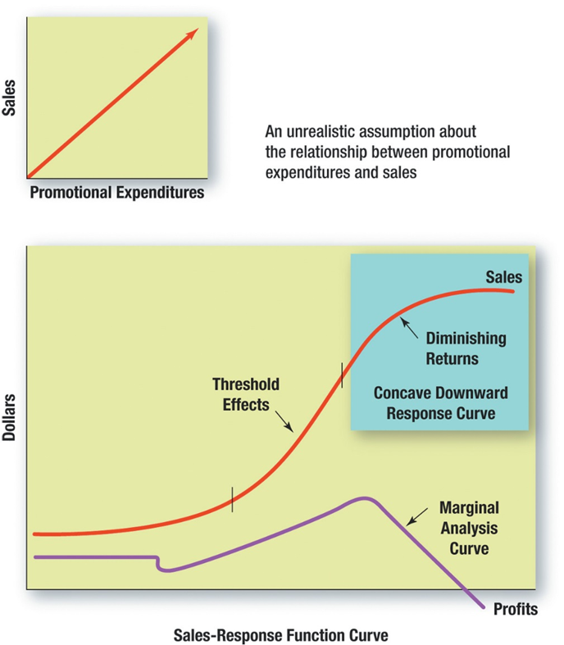
Figure 5.4: Relationships between Advertising and Marketing Expenditures and Sales and Profit Margins
Notes:
The straight line is an unrealistic assumption about the relationship between expenditures and sales. The bottom curve is more indicative of what happens. Advertising dollars are spent and for a while nothing happens. Then consumers begin to pay attention and start purchasing the product, the threshold effect. As more advertising dollars are spent, diminishing returns occur. With each additional dollar in advertising, the impact is less and less. This is the concave downward response curve.
The top graph shows a generalized linear relationship between sales on the y axis and promotional expenditures on the x axis, depicted with a 1 to 1 slope. It is labeled an unrealistic assumption about the relationship between promotional expenditures and sales.
The bottom graph has a y axis labeled dollars, and an x axis labeled sales response function curve. A purple line marked profits shows a function from left to right as follows, plateau, positive linear relationship, and negative linear relationship marked as marginal analysis curve. A red line marked sales starting with a higher y value shows a positive S curve with a rising function marked threshold effects, top of the curve marked diminishing returns and waning curve marked concave downward response curve.

Slide 18
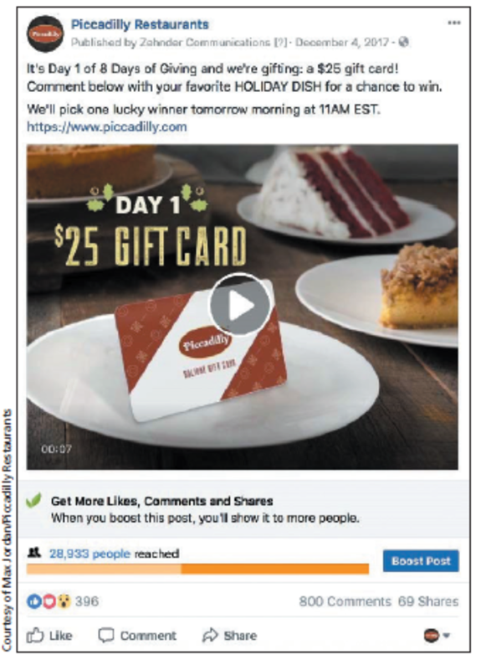
Threshold Effects
An advertisement designed to encourage action
Notes:
By offering a $25 gift card on a Facebook post, Piccadilly Restaurants seeks to move potential customers to reach the threshold effect level sooner.
The text in the post reads It’s day 1of 8 days of giving and we're gifting a $25 gift card. The post has reached 28,933 people and there is an option to boost the post.

Slide 19
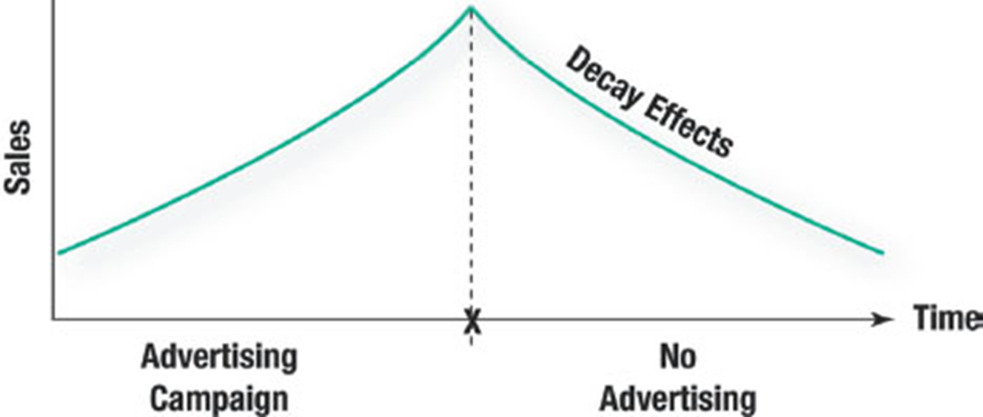
Figure 5.5: A Decay Effects Model
Notes:
This curve illustrates decay effect. During the advertising campaign, sales often continue to climb. Then the campaign ends and consumers begin to forget the brand name, thus it starts decaying.
The y axis is labeled sales, and the x axis is labeled time. The x axis is divided vertically by a dotted line labeled advertising campaign to the left of the dotted line and labeled no advertising to the right of the dotted line. A line rises from the y axis intersection to meet the dotted line, then falls with a line labeled decay effects.

Slide 20
Figure 5.6: Advantages of In-House versus External Agencies
In-House
Lower costs
Consistent brand message
Better understanding of product and mission
Faster ad production
Work closer with C E O
Lower turnover rate in the creative team
Outside Agency
Reduce costs
Greater expertise
Outsider’s perspective
Access to top talent
Notes:
Companies have to decide whether they will perform the advertising work in-house or obtain an outside advertising agency. Each has advantages. With an in-house staff, normally costs are lower. It is easier to ensure a consistent brand message across campaigns and across various products within the company. In-house staff have a better understanding of the product and the mission of the company. They usually will work closer with the CEO. With in-house, moving from creative to production is normally faster since the company has direct control of the employees. There is also a lower turnover in the creative team, which provides greater consistency across campaigns. Outside agencies also offer some advantages. Costs may be lower if the in-house team lacks the expertise and a lot of time and effort is wasted in doing the work. Outside agencies have greater expertise and an outsider’s perspective, which can be extremely valuable in generating fresh ideas and creating effective campaigns.

Slide 21
Figure 5.7: Common Services Provided by Full-Service Agencies
Advice about how to develop target markets
Specialized services for business markets
Suggestions about how to project a strong company image and theme
Assistance in selecting company logos and slogans
Preparation of advertisements
Planning and purchasing media time and space
Notes:
Full-service agencies provide a wide array of services for clients, everything from strategy development to actual ad preparation. Full-service agencies can offer advice and guidance on developing target markets, a brand’s image, logo and tagline development. Most full-service agencies can provide guidance on business markets as well as consumer markets. Media planning and buying is also done with a full-service agency, or one of its subsidiaries.

Slide 22
External Advertising Agencies
Advertising agencies
Media service companies
Direct marketing agencies
Consumer and trade promotion specialists
Digital services
Social media and mobile marketing
Public relations agencies
Notes:
Advertising agencies come in all sizes and shapes. They range from boutiques that offer only one type of service or serve one type of client to full-service agencies that offer the full spectrum of services. Advertising agencies will often provide other marketing services. Media services companies provide media planning and media buying services. Direct marketing agencies work with all types of direct response marketing campaigns. Some agencies specialize in consumer or trade promotions, or even focus on a specific type of promotion, such as couponing. Public relations firms handle both positive and negative publicity events. A growing number of agencies handle only online or social media.

Slide 23
Budget Allocation Considerations In-House versus Advertising Agency
Size of account should match size of agency
75-15-10 Rule
75% for media buys
15% for creative work (agency)
10% for ad production
Notes:
Costs are a major consideration in selecting an outside agency. The size of the account should match the size of the agency. Smaller accounts may be lost with a large agency and a large account would overwhelm a small agency. The 75-15-10 rule is a good guide to use. When looking at the total cost of an advertising campaign, 75% of the money should be spent on media buys, 15% on creative work by the agency, and 10% on production of the ads.

Slide 24

Crowdsourcing
Outsources creative aspect of ad or campaign to public
Winning examples:
Doritos
Harley Davidson
Overall cost not lower
Advantages
Involves consumers
Generates buzz
Notes:
Crowdsourcing is a recent alternative to choosing an advertising agency. Crowdsourcing involves seeking ideas from the public and even videos of ad productions. Two companies that have successfully used crowdsourcing include Harley Davidson and Doritos. Unilever used it for its meat snack product, Peparami. Doritos has used it in the Super Bowl. While it would appear the costs would be much lower, they are not. Most crowdsourcing involves a contest and a website. Then the entries have to be judged, and in most cases, the ad is professionally produced once the idea has been selected. But, the advantages of crowdsourcing include getting consumers involved and generating buzz among individuals as the entries are posted and passed along to other people.

Slide 25
Figure 5.8: Steps in Selecting an Advertising Agency
Set goals.
Select process and criteria.
Screen initial list of applicants.
Reduce list to two or three viable agencies.
Request creative pitch.
Notes:
Choosing an agency requires time and effort. While companies can shortcut the process, such an approach often results in the best agency not being hired. The first step is to select goals. Then the company should decide on a process and criteria before contacting any agencies. Once proposals have been received, the list can be narrowed down to two or three viable agencies. A creative pitch is then requested from each of the agencies to determine the best choice.

Slide 26
Choosing an Agency
Goal Setting
Set goals before contacting agencies
Provides direction
Reduces personal biases
Notes:
Goal setting should occur before contacting any agencies. Doing so will prevent any biases toward or against a particular agency. Also, the goals provide direction. It will help the company understand what it wants from an agency and where the company wants to go.

Slide 27
Figure 5.9: Evaluation Criteria in Choosing an Advertising Agency
Size of the agency
Relevant experience of the agency
Conflicts of interest
Creative reputation and capabilities
Production capabilities
Media purchasing capabilities
Other services available
Client retention rates
Personal chemistry
Notes:
The second step in the process is setting the evaluation criteria. Again, this should be done prior to talking to any agencies. As we have discussed, the size of the agency is important. The agency should have experience in the industry, but not be representing a direct competitor. This would be a conflict of interest. Creative reputation and capabilities should be considered since the primary role of the agency is to generate creative ideas. The product and media purchasing capabilities are not essential. Some agencies do this, while others use subsidiaries or contract the tasks out to boutique shops. Client retention rates may be important, but with the turnover among agencies today, it has lost a lot of importance. Personal chemistry is important because individuals from the two companies must work together and generate ideas that will move the brand forward and accomplish objectives that have been set.

Slide 28

Creative Pitch
Two to three finalists normally selected
Presentations address specific problem/situation
“Shootout” = competing formal presentations
Process is expensive for agencies
Notes:
Once the list has been narrowed down to two or three finalists, it is time to ask for competing creative pitches (a shootout). Agencies are given a specific problem to address. Creative pitches are expensive for agencies, so companies need to be serious about an agency when requesting a pitch. From the creative pitches, the company should select the agency that offers the best plan.

Slide 29
Figure 5.10: Pitching Do’s and Don’ts (1 of 2)
Do listen. Allow the client to talk.
Do your preparation. Know the client and its business.
Do make a good first impression. Dress up, not down.
Do a convincing job of presenting. Believe in what you are presenting.

Slide 30
Figure 5.10: Pitching Do’s and Don’ts (2 of 2)
Don’t assume all clients are the same. Each has a unique need.
Don’t try to solve the entire problem in the pitch.
Don’t be critical of the product or the competition.
Don’t overpromise. It will come back to haunt you.
Don’t spend a lot of time pitching credentials and references.

Slide 31
Roles of Advertising Personnel
Account executives
Creatives
Traffic managers
Account planners
Data scientists
Digital and social media managers, consultants
Notes:
In the advertising agency, there are some key individuals. The account executive is the liaison between the company and the agency. The account executive represents the client within the agency. Account planners are the voice of the consumer and assist in overall planning and strategic direction of the campaign. Their role is to see the total picture. The creative director is responsible for the creative aspect of the campaign and works with the agency’s creative staff. The traffic manager’s role is to manage the campaign scheduling to ensure the campaign is finished on time. As with the Oscar Mayer campaign, multiple components mean juggling numerous deadlines and schedules. Media buyers and planners are involved in the selection and purchase of media.

Slide 32
Figure 5.11: Advertising Campaign Parameters
Advertising goals
Media selection
Tagline
Consistency
Positioning
Campaign duration
Notes:
Effective advertising campaigns require careful planning and attention to these parameters. Advertising goals must be set based on communication and marketing objectives. Media selection not only must fit with the advertising goals but has a big influence on advertising design. A tagline needs to be developed, if not already in place. Consistency across campaigns and within a campaign is important to ensure the target audience is hearing the same, consistent message. Other decisions to consider include how the brand will be positioned and the duration of the campaign.

Slide 33
Figure 5.12: Common Advertising Goals
Build brand awareness
Provide information
Persuasion
Supporting marketing efforts
Encouraging action
Notes:
Marketers derive advertising goals from the firm’s overall company and targeted communication and objectives, as we discussed in Chapter 4. Advertising goals are often more specific outcomes designed to have an impact in a shorter time frame than the larger company objectives, which will be pursued over time. But they should remain consistent with the overall marketing communications approach and other components of the integrated marketing communications plan.

Slide 34

Advertising Goals: Providing Information
Notes:
In order to increase sales, advertisements for VW, like this one shown here, would include the goal of providing information about its vehicles’ self-parking feature.

Slide 35
Media Selection
Media usage habits of target market
Audience characteristics of media
Business-to-business media
Earlier involvement of media companies
Notes:
One of the challenging tasks of advertising management is to select the media that will be used. More information about this process will be presented in Chapter 7. But, at this point, it is important to realize that to pick the right combination of media requires understanding the media habits of the target market, then matching those habits with the audience characteristics of each media. This process is used in business-to-business media as well as in consumer media. Because of the importance of placing ads in the right media, companies are now involving media companies at an earlier stage of the ad development process rather than after the campaign has already been completed.

Slide 36
Taglines
Key phrase
Memorable
Conveys uniqueness
Consistency across platforms
Shorter than in past
Revised or new taglines
Notes:
Taglines are connected with brands and sometimes are better known than a brand’s logo. It is a key phrase that should tell what the brand is about. It should be memorable and convey something that is unique. The tagline should be consistent across multiple media platforms. Over time, taglines have become shorter. Revising taglines can be tricky and must be managed carefully.

Slide 37
Figure 5.13: Taglines Used by Various Brands (1 of 2)
American Express—“Don’t leave home without it.”
Avis—“We try harder.”
Bounty—“The quicker picker-upper.”
Capital One—“What’s in your wallet?”
C N N—“The most trusted name in news.”
Energizer—“It keeps going, and going, and going.”
Hallmark—“When you care enough to send the very best.”

Slide 38
Figure 5.13: Taglines Used by Various Brands (2 of 2)
John Deere—“Nothing runs like a Deere.”
Maxwell House—“Good to the last drop.”
Nokia—“Connecting people.”
Office Depot—“Taking care of business.”
Target—“Expect more. Pay less.”
U P S—“What can Brown do for you?”
Walmart—“Save money. Live better.”

Slide 39
Questions to Consider (2 of 2)
Which of these taglines do you think are the most memorable?
Which ones do you think are the most effective?
Which of these brands have you used because you remembered or liked its tagline?

Slide 40


Consistency
Helps embed brand into long-term memory
Visual consistency key
Repetition enhances recall
Variability theory
Different environments
Can vary content
Multiple media
Notes:
Repeatedly seeing a specific visual image, headline, copy, or tagline helps embed a brand into a person’s long-term memory. Visual consistency is especially important in moving an ad to long-term memory. Repetition enhances both ad recall as well as brand recall. Variability theory states that seeing an advertisement in different environments enhances recall and recognition. Advertisers can vary the ad content while maintaining consistency across the campaign or campaigns. Different media can also be used. Seeing an ad on television and then in a magazine or billboard enhances recall more than seeing multiple ads within the same medium. These two ads for Cross Keys Bank use variability theory concepts to create consistency within the campaign.

Slide 41
Positioning
Maintain consistent position
Link in cognitive map
Avoids ambiguity
Message stays clear
Notes:
Maintaining consistent product positioning throughout a brand’s life makes it easier for individuals to embed the brand within their cognitive map. Consistent positioning avoids ambiguity and provides a clear, consistent message that is always the same.

Slide 42
Campaign Duration
Goal is to embed into long-term memory
Length varies
Too long can make it stale
Too short impedes retention
Delay wear-out effects with multiple ad versions
Notes:
The goal of an ad campaign is to embed the brand and the message into a person’s long-term memory and cognitive map structure. If the campaign is too short, it impedes retention. It also leads to greater costs. If the campaign is too long, it can become stale and consumers will lose interest. It is also possible the campaign can create negative feelings from hearing it too much.

Slide 43
Figure 5.14: The Creative Brief
The objective
The target audience
The message theme
The support
The constraints
Notes:
The last step in advertising management is writing a creative brief. The appearance of creative briefs will vary among advertising agencies and clients, but most contain these five elements: the objective of the campaign, the target audience, the message theme, any support that can be used, and any constraints. The creative brief is prepared by the agency with the help of the account executive or account planner from the agency and the brand manager from the client. It is a document used by the creative team at the agency to prepare the advertising campaign, so it needs to be clear and provide enough information so that the creative team understands what the client wants.

Slide 44

The Target Audience
Creatives must fully grasp it
General profiles do not help
Useful information:
Hobbies
Interests
Opinions
Lifestyles
Notes:
Information about the target audience is critical. It should be more than just demographic information.

Slide 45
The Message Theme
Unique selling point
“Left brain” advertisement
Logical, rational side of brain
Manages numbers, letters, words, concepts
Use rational appeal
“Right-brain” advertisement
Emotional side of brain
Manages abstract ideas, images, feelings
Use emotional appeal
Notes:
The message theme should be the one (not multiple) unique selling point the client wants its target audience to get. When considering message themes, it helps to think about the difference between left brain messages and right brain messages. The left side of the brain is logical and where people manage numbers, letters, words, and concepts. Left brain advertising focuses on rational appeals that require thought, the cognitive component of attitude. The right side of the brain is where the emotions lie. The right side manages abstract ideas, images, and feelings. So right brain advertising should use an emotional appeal, the affective component of attitude.

Slide 46
The Support
Should be the fourth component of the creative brief.
Facts that substantiate the message theme.
Examples:
Aveeno’s “Best of Beauty” seal
Oral B: Accepted by the A D A
Humira: F D A-approved for over 16 years
Notes:
Ads will often provide support for their product. It is the responsibility of the client to provide any support that might be used in an advertising campaign. For example, if an automobile was designated as Motor Trend’s car of the year, that is valuable support that can be included to support brand image advertising.

Slide 47
The Constraints
Legal and mandatory restrictions
Legal protection for trademarks, logos, and copyright
Corporate restrictions
Disclaimers
Notes:
Constraints are things advertising can’t say or do, or things that must be included in ads. For some products, there are legal and mandatory restrictions that must be included. For drugs, companies must tell consumers about all of the possible side effects. For tobacco products there must be a warning from the Surgeon General. Companies may have other constraints, such as the logo must appear in all ads, or the logo must be in a specific color or shape. Disclaimers or warranty statements may also be included in ads. Most of the constraints are either legal requirements or company-imposed requirements to protect from lawsuits.

Slide 48
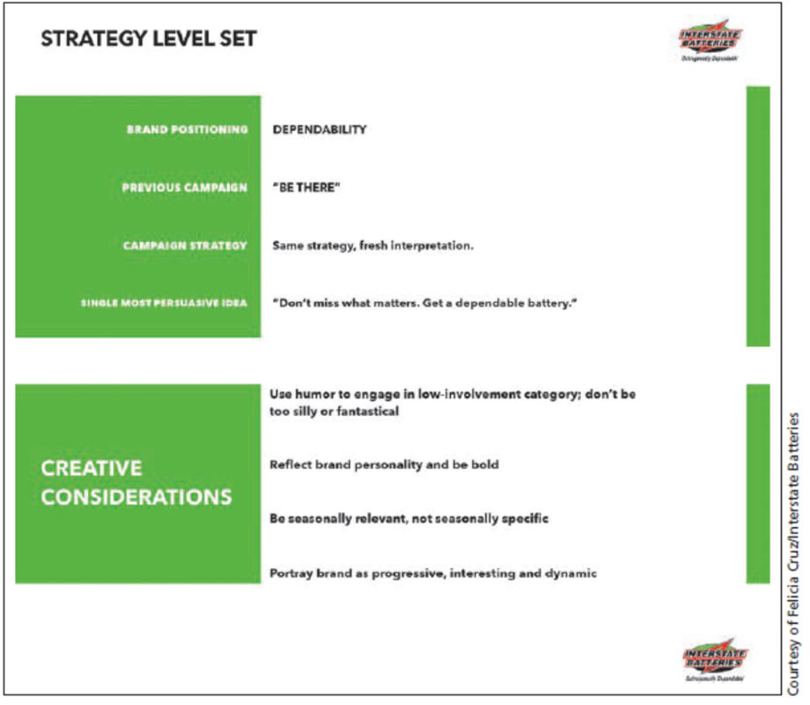
An Example of Creative Concepts
Notes:
These concepts developed by the marketing team for Interstate Batteries would be part of a creative brief.
The concepts titled below strategy level set are as follows.
Brand positioning, dependability
The previous campaign, be there
Campaign Strategy, same strategy, fresh interpretation
The single most persuasive idea, don’t miss what matters, get a dependable battery
The concepts related to creative considerations are as follows.
Use humor to engage in the low involvement category, don’t be too silly or fantastical
Reflect brand personality and be bold
Be seasonally relevant, not seasonally specific
Portray brand as progressive, interesting, and dynamic

Slide 49
International Implications
Significant advertising expenditures made overseas
Two major differences
Process of agency selection
Preparation of international advertising campaigns
Preplanning research varies
Understanding of languages and cultures
Media selection varies
Notes:
Advertising management involves significant expenditures overseas. The two major differences are the process of selecting an agency and the preparation needed for an international advertising campaign. Preplanning will also vary across countries. When developing global ad campaigns, you have to pay close attention to language and culture differences. Translating to another language is not sufficient. Media selection also varies in other countries. The mix that is used in the U.S. is not the same as it would be, for example, in Japan, Peru, Spain, or Germany.

Slide 50
Your Career: Advertising Theory and a Job Search
Advertising theories from Ch. 5 apply to individual careers
Hierarchy of Effects Model:
Awareness
Knowledge
Liking
Conviction
Purchase
Notes:
How can these five stages of the Hierarchy of Effects Model apply to your job search and career development?

Slide 51
Blog Exercises
Flu Treatments
Leg Shaving
Oreo Cookies
Notes:
The blog exercises for Chapter 5 include Flu Treatments, Leg Shaving, Oreo Cookies, videos about advertising agencies. Links are embedded in the text for each.

Slide 52

Copyright
This work is protected by United States copyright laws and is provided solely for the use of instructors in teaching their courses and assessing student learning. Dissemination or sale of any part of this work (including on the World Wide Web) will destroy the integrity of the work and is not permitted. The work and materials from it should never be made available to students except by instructors using the accompanying text in their classes. All recipients of this work are expected to abide by these restrictions and to honor the intended pedagogical purposes and the needs of other instructors who rely on these materials.

